Slide 1

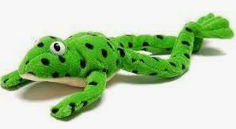
Welcome to phonics at Oakwood Primary Academy.
The Read, Write, Inc. way.

Slide 2



What is phonics?
Sounds & Graphemes
Notes:
All words are made up of individual sounds. These sounds are merged together to form words.
e.g. in ‘mat’ we have the sounds ‘m’, ‘a’, ‘t’, ship – ‘sh’, ‘i’, ‘p’.
A grapheme is another name for the letters we use to write the sound. The spelling of that sound on the page.
Phonics is the method of teaching reading through the identification of sounds and graphemes.
The National Curriculum ensures that all children are taught Phonics systematically. This gives your children the tools to read words.

Slide 3
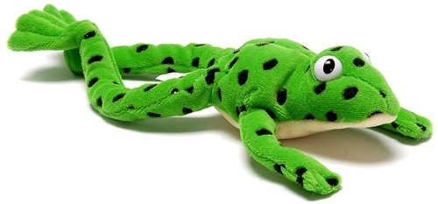
Fred games and Fred talk throughout the day
l
-u
?
Shall we have some
What would you like to
Let’s put on your
-ch
-n
-ay
-l
p
?
-oa
-t
c
.
Notes:
Try to use Fred Talk at home to help your child practise blending sounds together.
Fred Talk words at the end of the sentence and keep the words short and simple.
With the person next to you, have a practise of the three sentences on the screen. Remember to Fred Talk the last word of the sentence.
You can also play Fred Games with your child at home.

Slide 4
Speed Sounds Set 1 https://www.youtube.com/watch?v=TkXcabDUg7Q
Notes:
Remember that:- Children need to know sounds – not letter names – to read words.
- We pronounce the sounds clearly, using pure sounds (‘m’ not’ muh’, ’s’ not ‘suh’, etc.) so that your child will be able to blend the sounds together to make words more easily. (watch video clip)

Slide 5
Speed Sounds Set 2
Notes:
Set 2 sounds are shaded. They are long vowel sounds with 2 or more letters. We call these ‘Special Friends’ – two letters together that make one sound.
Demo-MTYT use big picture cards. Once children know these Set 2 sounds, they know one way of reading and writing every sound.

Slide 6
Speed Sounds Set 3
Notes:
Once children know how to read Set 2 sounds, they start to learn Set 3 sounds.
These are shaded in the chart.
They are alternative graphemes (spelling of a sound) for the Set 1 and Set 2 sounds the children already know.
For example, they know ‘ay’ and now learn a-e and ai as other spellings for the same sound.

Slide 7
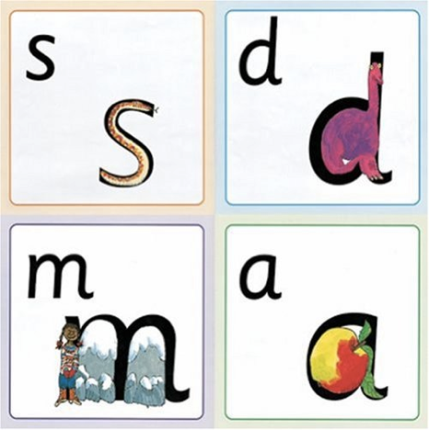
Name the pictures
Notes:
We give children a hook to learn the sounds by using pictures in the same shape as the letter.
‘s’ looks like a snake. ‘d’ looks like a dinosaur. ‘m’ looks like a mountain. ‘a’ looks like an apple.
We teach the children to name the mnemonic pictures before they learn the sound. This means that children learn to read and write the sounds really easily.

Slide 8
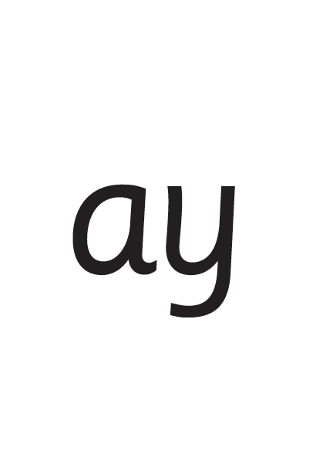
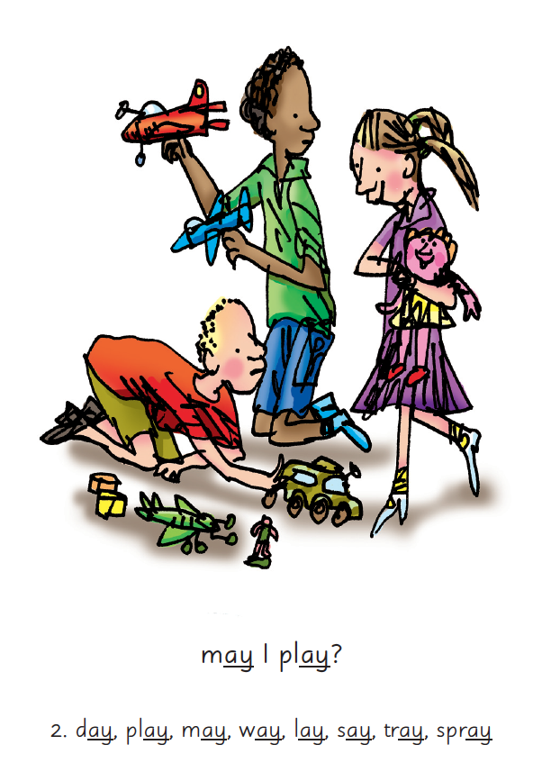

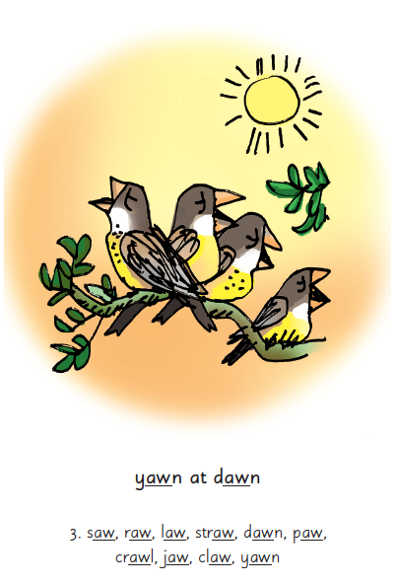
Picture Phrases
Notes:
We use picture phrases to help children remember the Set 2 and Set 3 sounds. Eg- ay, may I play? aw, yawn at dawn

Slide 9
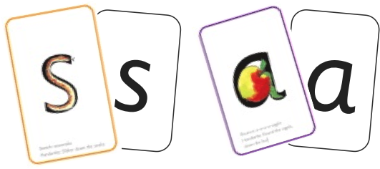

Sounds + blending = reading
+
Notes:
Alongside teaching children sounds, we teach them to blend sounds to read words e.g. s-a-t, sat. We use Fred Talk to help children read.

Slide 10

Reading with Fred Talk
Notes:
We teach children to read words using Fred Talk to blend together the sounds they know e.g. m-a-t, mat. We say ‘Fred Talk, read the word’.

Slide 11


‘Special Friends’, ‘Fred Talk’, read the word
Notes:
Then children practise reading these sounds in words using the routine ‘Special Friends’, ‘Fred Talk’, read the word’.
They spot the ‘Special Friends’ first, then Fred Talk to read the word. Eg- ‘ay’, s-p-r-ay, spray.

Slide 12
Fred Talk routine
Say the word in sounds as Fred e.g. c-a-t.
Ask your child to repeat. Can they ‘jump-in’ with the whole word?
Say the word in sounds followed by the whole word e.g. c-a-t, cat
Ask your child to repeat
Notes:
Fred Talk follows a consistent routine.

Slide 13



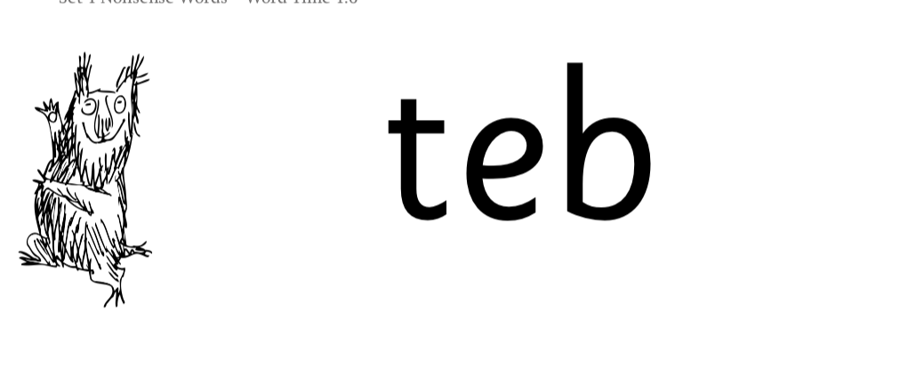
Nonsense words
Notes:
Half of the words in the check are real words.
Half are nonsense words. For example, ‘sheb’, ‘glight’, ‘ched’, ‘teb’.
There is a picture of an alien next to each word to remind the children that it isn’t a real word.
Nonsense words check that children will be able to read sounds they know in unfamiliar words.
Children who can read nonsense words will, very soon, be able to read any new word – for example – gargantuan, flailing, raucous, anticipation;
Reading new words increases children’s vocabulary rapidly.

Slide 14
‘Three with me, four at home’
Accuracy
Fluency
Comprehension
Read and enjoy at home
Notes:
In our school, children read each Read Write Inc. Storybook three times in class with their partner.
Re-reading the same book helps children to become confident readers. Each time they re-read, they build their fluency/speed and comprehension.
They love reading and want to read because they can read all of the words in the Storybook. We set a focus for each re-read in school.
The first read focuses on reading every word accurately.
The second on reading the story more quickly.
The third read on comprehension - understanding what they read.
We do not send stories home the children cannot read because we always want them to be set up to succeed in their reading.
We want to make sure they enjoy reading so that they want to read. The more they read, the faster progress they will make.

Slide 15

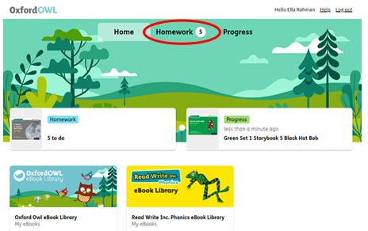
After the third read…
https://www.oxfordowl.co.uk
We will set up a homework link on
www.oxfordowl.co.uk
so your child can then read the same book at home and enjoy the accompanying quiz.
Every child will have their own username.
Notes:
So after the third read in class, children can read the same book online.
They love this book! They can read it like a storyteller and can’t wait to read it to you, their grandparents or even their teddy bear!
Please avoid saying, “This book is too easy for you!” but instead say “I love how well you can read this book!”
They are meant to be able to read all of the words as the book is at the correct level.
Encourage them to share their enjoyment of the story with you and read it in their storyteller voice – again and again.

Slide 16

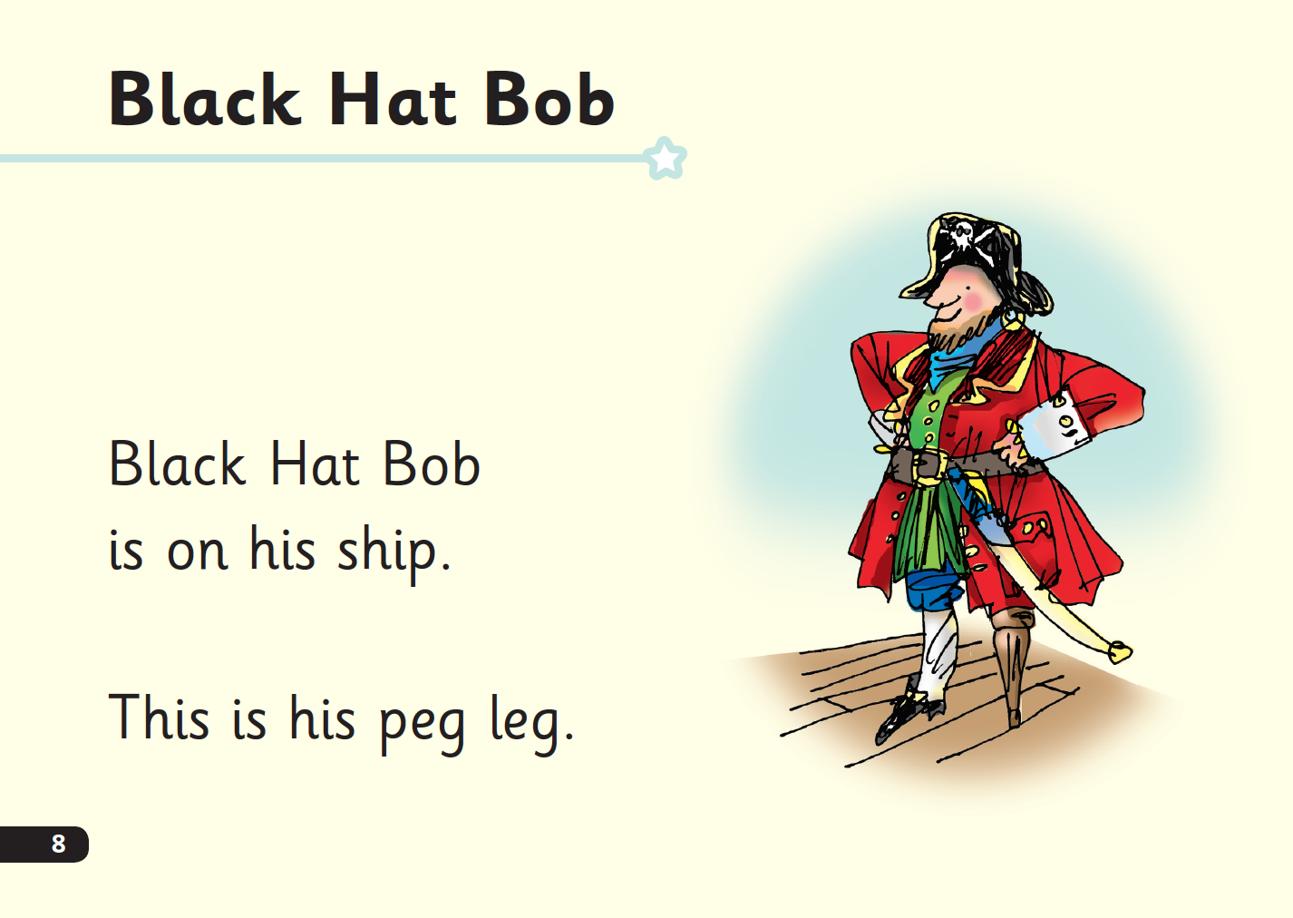
‘Special Friends’, ‘Fred Talk’, read the word
Notes:
Children will be able to read all of the words in the Storybook. If they hesitate, remind them to read the word using ‘Special Friends, Fred Talk, read the word’.
For example, this means they spot the ‘sh’, then Fred Talk and blend to read the word e.g. sh, sh-i-p, ship.

Slide 17

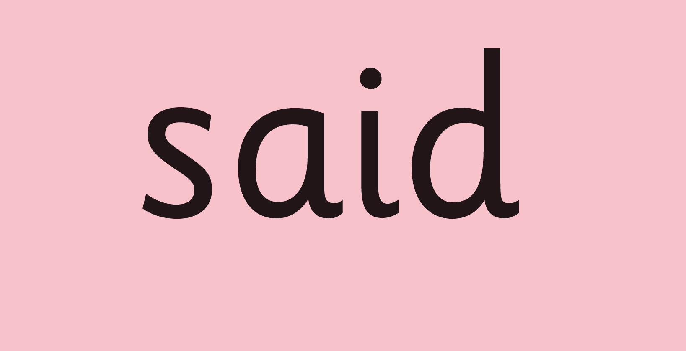
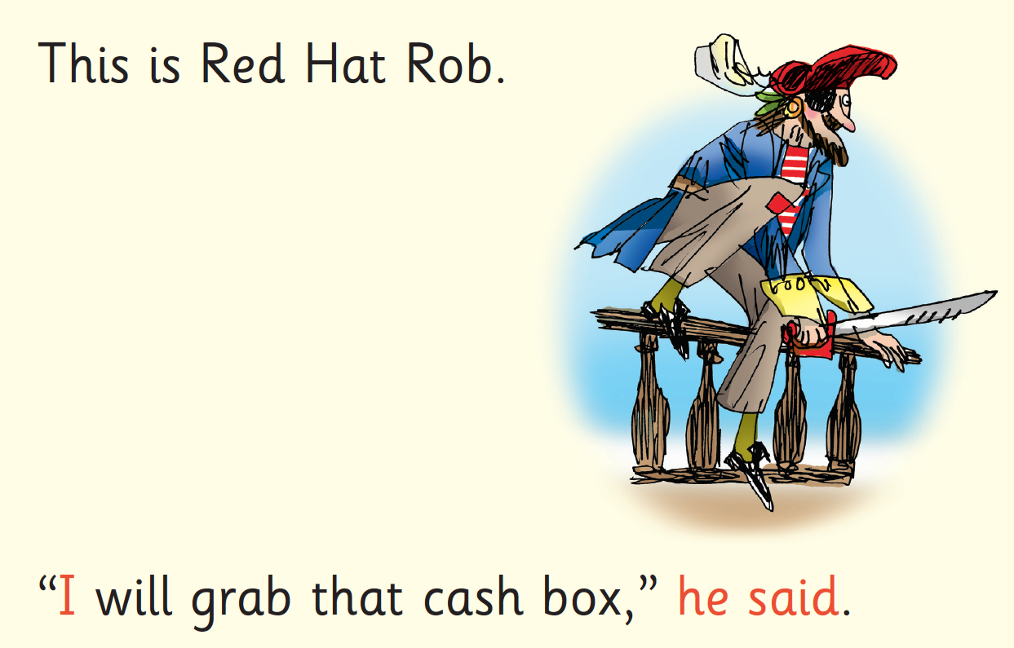
Red Words
Notes:
Some words are ‘tricky’ because they contain letters that don’t match the sounds the child has been taught.
For example, ‘said’ has ‘ai’ making an ‘e’ sound. We teach these common exception words as Red words.
In the early Storybooks, these words are printed in red text.
Remind your child not to use Fred Talk to read Red words but instead to stop and think. Tell them the word if needed.

Slide 18
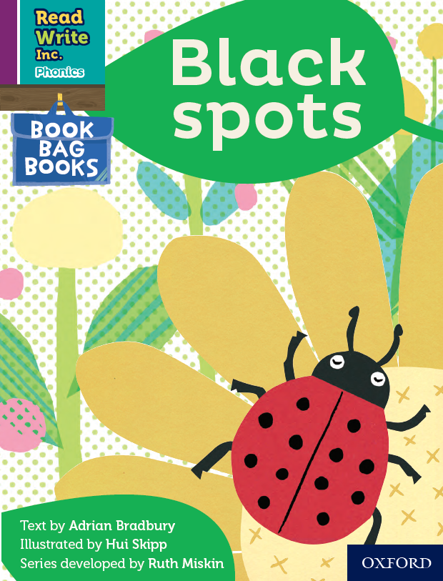
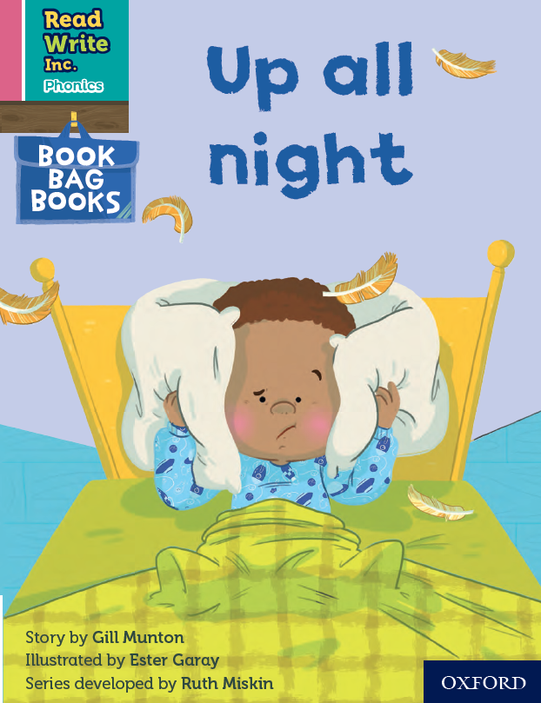
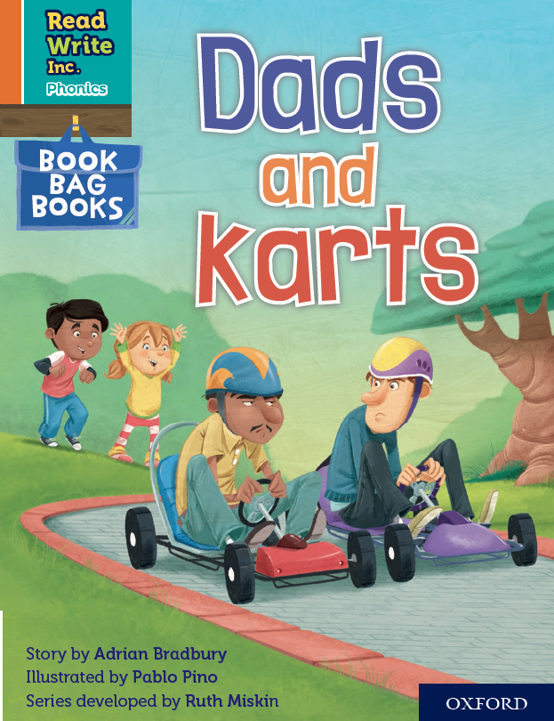

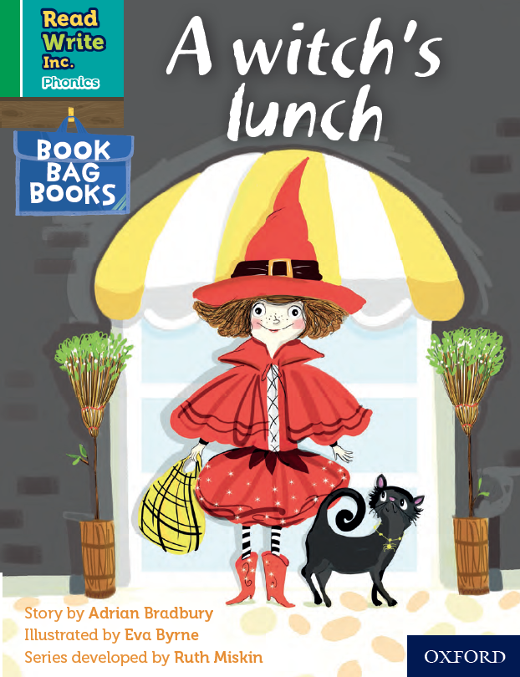
Book Bag Books
Extra reading practice at home
Uniquely matched to the Read Write Inc. Phonics Storybooks.
Reinforce children's learning of phonics at the appropriate level.
Helps to make even faster progress in reading.
Notes:
We use Book Bag Books especially for home reading. They have guidance inside just for you as parents.
They are matched to the books children read in school so provide practice of the same sounds – extra practice at the right level for your child.
They include many of the same reading activities that we use in class.

Slide 19
What can you do?
Listen to your child read the same Storybook again and again
Encourage them to use ’Special Friends’, ‘Fred Talk’, ‘read the word’
Discuss the story and encourage their storyteller voice.
Write a positive comment in your child’s reading journal.
Notes:
See ‘Reading at Home Booklet 1 or 2’ from Oxford Owl.
Booklet 1 is sound groups and Ditty/ Red Groups and Booklet 2 for Green – Grey Storybooks.

Slide 20


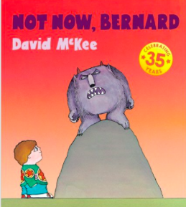

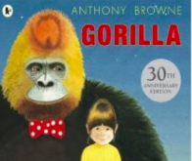
Repeated readings
Again! Again!
Children are wired to thrive on repetition
Notes:
Stories provide a wealth of language we don’t use in everyday talk.
The more stories, poems and nursery rhymes children know well, the more easily they will be able to understand what they read, when they can read.

Slide 21
10 things your child learns when you read aloud stories and poems every day
Sustain attention.
Appreciate rhythm and rhyme.
Build pictures in their minds from the words on the page.
Understand humour and irony.
Use new words and phrases in different contexts - and later in writing.
Learn new vocabulary and knowledge of the world.
Think about characters’ feelings and use appropriate voices.
Follow a plot with all its twists and turns.
Understand suspense and predict what’s about to happen next.
Link sentences and ideas from one passage to the next.
Notes:
Look at all these things you child will learn when you read aloud stories and poems, - without any teaching!

Slide 22
Top Tips - Storytime
Make it a treat
Make it a special quiet time
Show curiosity
Read story once without stopping
Chat about the story
Avoid testing with questions
Link to other stories and experiences
Read favourites over and over again
Use different voices
Love the book
Notes:
Here are our ten top tips for Storytime at home.
Make it a treat – introduce each new book with excitement.
Make it a special quiet time – cuddle up!
Show curiosity in what you’re going to read.
Read story once without stopping so they can enjoy the whole story. . If you think your child might not understand something say something like ‘Oh I think what’s happening here is that…”
Chat about the story e.g. I wonder why he did that? Oh no, I hope she’s not going to…
Avoid asking questions to test what they remember.
Link to other stories and experiences you have shared e.g. this reminds me of…
Read favourites over and over again – encourage your child to join with the bits they know. Avoid saying ‘not that story again!’
Use different voices – be enthusiastic!
Love the book – read with enjoyment.
I will give you a handout with these tips when you leave today.

Slide 23

Online resources available
Free e-books for home reading:
http://www.oxfordowl.co.uk/Reading/
Phonic games
https://www.phonicsplay.co.uk/resources
https://www.topmarks.co.uk/english-games/5-7-years/letters-and-sounds

Slide 24
The more that you read, the more things you will know. The more that you learn, the more places you’ll go!
Dr. Seuss
Notes:
In the words of Dr Seuss…read quote. Good readers do well in school – and in life.
By listening to your child read, you are making sure they have the opportunity to practise and become a good reader quickly.

